Slide 1
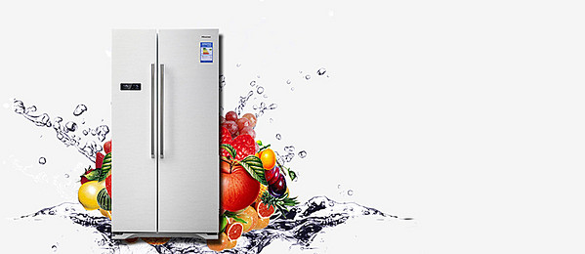
Unit 3:
REFRIGERATOR

Slide 2
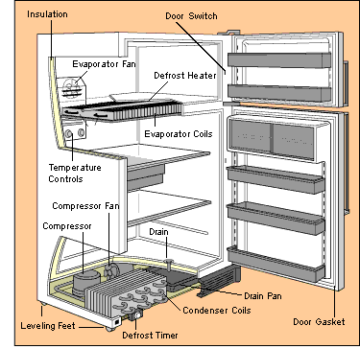

Slide 3
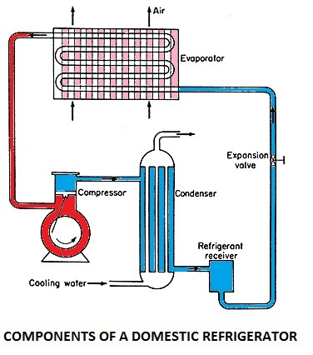

Slide 4
VOCABULARY
compressor
condenser
capillary
evaporator
refrigerant
refrigeration progress
over-frozen

Slide 5
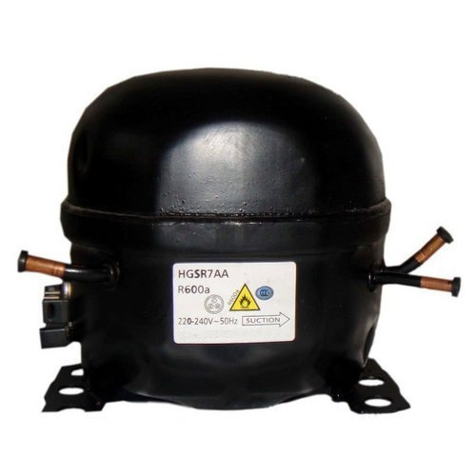
VOCABULARY
compressor

Slide 6
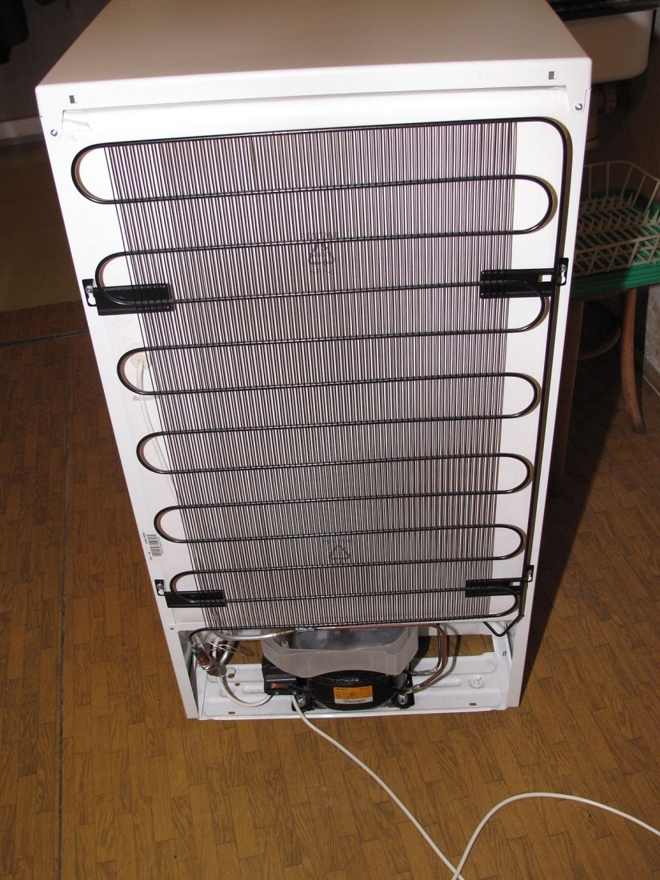
VOCABULARY
condenser

Slide 7
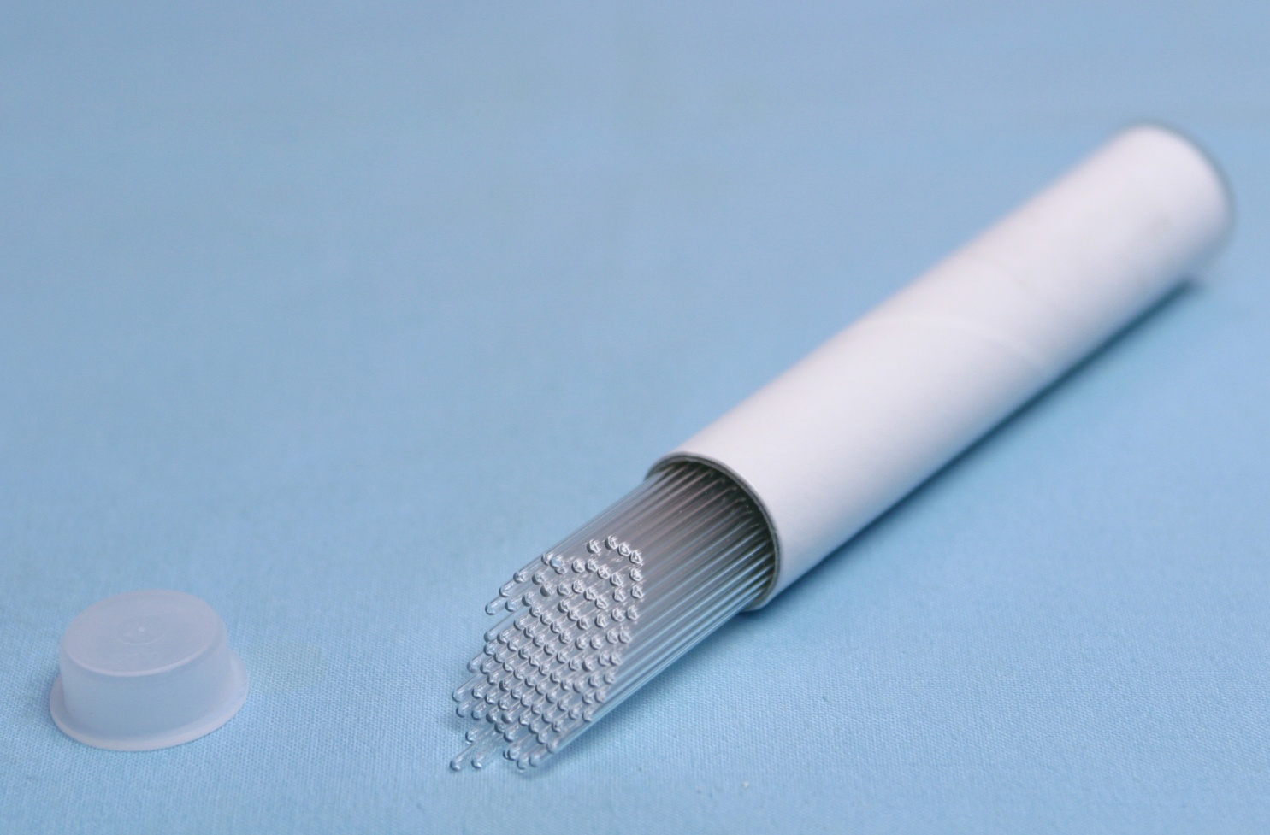
VOCABULARY
capillary

Slide 8
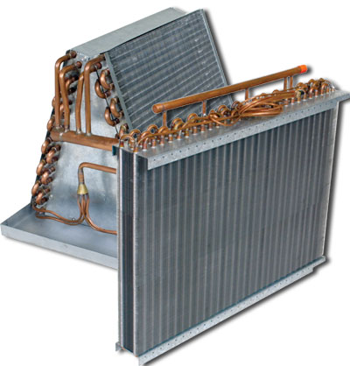
VOCABULARY
evaporator

Slide 9
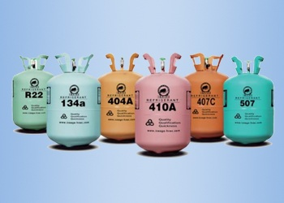
VOCABULARY
refrigerants

Slide 10
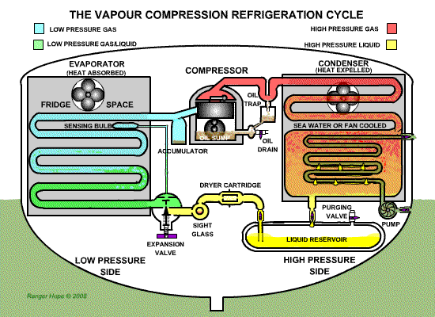

Slide 11
Language study
When/ If + action, result.
(present tense)
(present tense)
If a liquid is heated, it changes to a gas or vapour.
When a gas is allowed to expand, it cools down.

Slide 12
Word study
VERB
NOUN
compress
compressor
refrigerate
refrigerator
condense
condenser
…
…

Slide 13
writing
Describe the refrigerator process

Slide 14
THANK YOU !

